Slide 1
ANALYST BOOT CAMP ALGEBRA & STATISTICS MARCH 2025 MUIP00071
Notes:
Through Slide 8 (00:10)
You are welcome to use a calculator or open Excel to do your work.
Instructor Notes: We will visit a topic 3 times.
Ppt slide
Khan Academy video
Practice problems in excel spreadsheet workbook.
Have students save a local copy of the workbook spreadsheet for participation. Open spreadsheet and save a copy.

Slide 2
HOUSEKEEPING
Actively participate; Do not multitask or do other things during class time.
Close other applications (including email).
Be prepared to hear your name.
Use the “raise your hand button” when you have questions.
We will use a “parking lot” for questions that are out of scope for this class.
I will frequently ask “does everyone follow that” because I can’t see your faces.

Slide 3
PRE-TEST
2 X 2 + 2 X 2 =
Rebase the series to the last number: 5, 7, 15, 12, 6
What are the first 2 terms of the MA3 for the series above:
The average is a measure of the __________ of a set of data.
The standard deviation is a measure of the ______ of a set of data.
In a Normal Distribution (mean=100, SD=15), what Z-scores include 95% of the data values?__
Explain the Central Limit Theorem? ___________
Given a data set of 15 values should we use the z-score or t-score? __
The most common level of significance used for Confidence Intervals is: __

Slide 4
COURSE GOALS
Develop an understanding of Algebra,& Statistical Analytical concepts.
Demonstrate that understanding by solving practical problems using Excel.

Slide 5
QUANTITATIVE ANALYSIS BASICS
Order of Operations, Square Roots, Exponents
Calculation of Average – Mean, Median, Mode
Calculation of Standard Deviation
Weighted Average
Moving Average
Growth Rate
Indexing
Rebasing

Slide 6


SYMBOLS
Arithmetic Symbols
Multiplication$∗$ $×$ $∙$
Division / $\frac{a}{b}$ $÷$
Parentheses ( )
Brackets [ ] { }
Exponents $x$ ^ 2, $x$²
Subscripts $x$₁ , $x$₂
Logical Symbols
$=$ Equal to
$≠$ Not Equal to
≤ Less than or equal to
$≥$ Greater than or equal to
$<$ Less than
$>$ Greater than

Slide 7
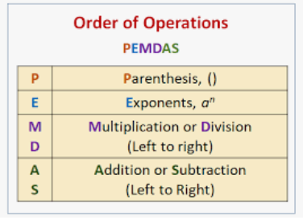
ORDER OF OPERATIONS (PEMDAS)
The Order of Operations matters because we can get different answers to the same problem.
Mathematicians agree to use PEMDAS.
Multiplication is not ranked before division, as M before D might suggest. They are ranked equal in the 3rd tier. We work on an algebraic expression from left-to-right within the tier.
The same rules hold for addition vs. subtraction in the 4th tier.
Notes:
Please Excuse My Dear Aunt Sally

Slide 8
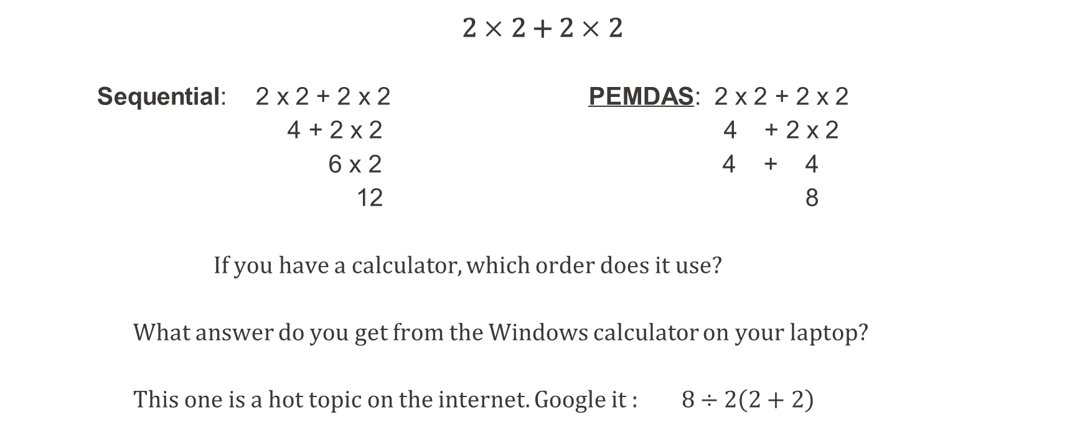
THE ORDER OF OPERATIONS MATTERS
PEMDAS
2 $×$ 2 + 2 $×$ 2
Sequential: 2 x 2 + 2 x 2 PEMDAS: 2 x 2 + 2 x 2
4 + 2 x 2 4 + 2 x 2
6 x 2 4 + 4
12 8
If you have a calculator, which order does it use?
What answer do you get from the Windows calculator on your laptop?
This one is a hot topic on the internet. Google it : $8÷2\left(2+2\right)$

Slide 9
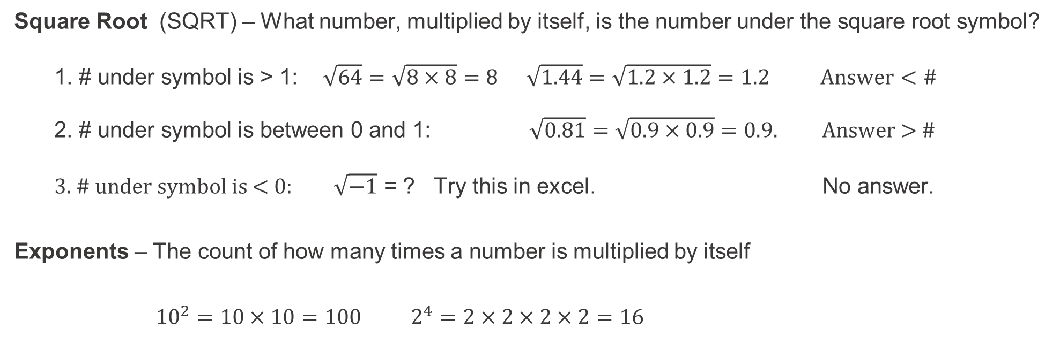
SQUARE ROOTS & EXPONENTS
Square Root (SQRT) – What number, multiplied by itself, is the number under the square root symbol?
1. # under symbol is > 1: $\sqrt{64}=\sqrt{8×8}=8$ $\sqrt{1.44}=\sqrt{1.2×1.2}=1.2$ $Answer<\#$
2. # under symbol is between 0 and 1: $\sqrt{0.81}=\sqrt{0.9×0.9}=0.9.$ Answer > #
3. # under symbol is < 0: $\sqrt{−1}$ = ? Try this in excel. No answer.
Exponents – The count of how many times a number is multiplied by itself
${10}^{2}=10×10=100$ $2^{4}=2×2×2×2=16$

Slide 10
CALCULATION OF AVERAGES
The average is a measure of “central tendency” of the data.
Example: [ 2, 2, 2, 4, 10 ]
There are 3 common types of averages, calculated as:
The MEAN: Add up the data points and then divide by the number of data points.
2+2+2+4+10 = 20 20/5 = 4 Mean = 4
The MEDIAN: Arrange the numbers in order, then pick the middle number. Median = 2
The MODE: The number that appears most often. Mode = 2. If there are no repeats,
the mode does not exist.

Slide 11
CALCULATION OF STANDARD DEVIATION (SD)
Standard Deviation (SD) is a measure of how “spread out” the data is.
The calculation uses PEMDAS, Square Roots, and Exponents.
Ex 1. ( 2, 2, 2, 4, 10 ) has a mean of 4. SD is a measure of the deviations from 4.
SD = SQRT ( ( (2-4)^2 + (2-4)^2 + (2-4)^2 + (4-4)^2 + (10-4)^2 ) / 5 )
= SQRT ( ( 2^2 + 2^2 + 2^2 + 0 + 6^2) / 5)
= SQRT ( ( 4 + 4 + 4 + 0 + 36 ) / 5 )
= SQRT (48/5) = SQRT (9.6) = 3.09
Ex 2. To compare, ( 2, 3, 4, 5, 6 ) also has a mean of 4, but the SD is:
SD = SQRT ( ( (2-4)^2 + (3-4)^2 + (4-4)^2 + (5-4)^2 + (6-4)^2 ) / 5 )
= SQRT ( ( 2^2 + 1^2 + 0^2 + 1^2 + 2^2 ) / 5 )
= SQRT ( (4 + 1 + 0 + 1 + 4) ) / 5 )
= SQRT (10/5) = SQRT (2) = 1.41
Both sets have the same mean = 4, but the first is more “spread out” and has a bigger SD.

Slide 12
EXCEL EXERCISES
Go to the Excel exercises in your workbook. The answers are to the far right on each tab.
Tabs
OrdOps
SqR_Exp
Avg
SD

Slide 13
WEIGHTED AVERAGE – EASY Example
Weighted Average gives more weight to the more important segments of data.
Notes:
Walk through Loss Ratio Example in Excel file: Weighted Average 1.

Slide 14
WEIGHTED AVERAGE in GAINSHARE
Weighted Average gives more weight to the more important segments of data.
PL Direct has more importance than H/O because there are more Premiums.
PGR targets CR < 0.96 or Profit Margin > 0.04
.
.
Often people want to use the “average of averages” because it sounds good. But they are assuming all segments have the same weight and that is generally not a valid assumption.
Notes:
Walk through Loss Ratio Example in Excel file: Weighted Average 1.

Slide 15
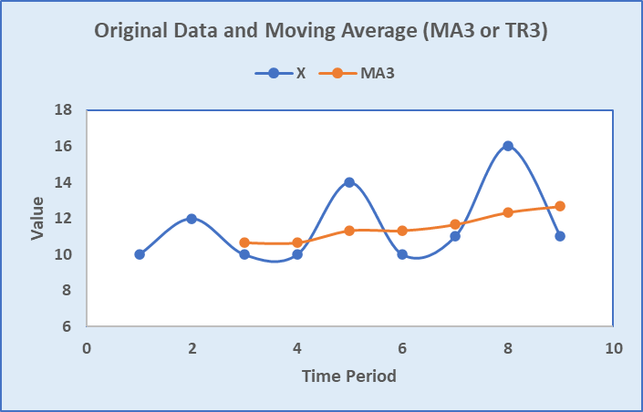
MOVING AVERAGE MAn or TRn where n = # of data points
The two purposes of a Moving Average are to
smooth out fluctuations in the data and
remove seasonality (usually MA12 or TR3) to show trend
Notes:
Analysts are consistently asked, year over year – how did it change?
What would happen if May was 32,000 and October was 23,000? A: 28% decrease.
This is a good time to show that a 50% decrease (from 32,000 to 16,000) requires a 100% increase to get back to where you started. Use excel tab.

Slide 16
GROWTH RATE
Growth Rate is the percent change of a quantity from start to end of a time period. It can be positive or negative. There are 2 ways to calculate it. You should be familiar with both.
Notes:
Analysts are consistently asked, year over year – how did it change?
What would happen if May was 32,000 and October was 23,000? A: 28% decrease.
This is a good time to show that a 50% decrease (from 32,000 to 16,000) requires a 100% increase to get back to where you started. Use excel tab.

Slide 17
GROWTH RATE
Caveat: It really doesn’t make sense to calculate the growth rate if the starting and ending values are of opposite signs (one is positive and one is negative), but people still do it.
Notes:
Analysts are consistently asked, year over year – how did it change?
What would happen if May was 32,000 and October was 23,000? A: 28% decrease.
This is a good time to show that a 50% decrease (from 32,000 to 16,000) requires a 100% increase to get back to where you started. Use excel tab.

Slide 18
INDEXING
Divide all the numbers in a series by the first number. This sets the first number equal to 1.00
Then multiply the newly created numbers by 100. This creates an Indexed Series.
Example: Economic series (CPI, PPI)
Q1 Q2 Q3 Q4
87 95 108 120
1.00 1.09 1.24 1.38
100 109 124 138
Why do we create an index? Because it is easy to interpret:
Q2 is 9% higher than Q1
Q4 is 38% higher than Q1

Slide 19
REBASING AND RELATIVITIES
Rebase: Divide the base (reference number) by itself. This sets the Base = 1.00
Relativities: The ratios of other numbers to the base.
Many reports at PGR use “Loss Ratio Relativities” or “Pure Premium Relativities”. Here is an example where we re-base to the Total Combined Ratio (CR) and calculate relativities.
Combined Ratio is (1 – Profit Margin) and is a metric used in insurance.
Indexing is basically re-basing to the first term of the series of numbers.

Slide 20
EXCEL EXERCISES
Go to the Excel exercises. Answers are to the far right on each tab.
Tabs
WtdAvg
MovAvg
Growth Rate
Index
Rebase

Slide 21
STATISTICS

Slide 22
STATISTICS BASICS
The fundamental relationship of a Sample to a Population
Descriptive Statistics
Center and spread of the data
Outliers
Visualizations
Inferential Statistics: infer population parameters from sample parameters
Correlation & Causation
Linear Regression
Types of Distributions
Normal Distribution
Z-scores & Standard Normal Distribution
Central Limit Theorem

Slide 23
KEY CONCEPT: POPULATION VS.SAMPLE
Population: An entire group of people or objects of interest
Sample: A subset of the population. Hopefully representative of the population.
Samples are used because we can’t get the entire population, or it is too expensive to get.
Examples:
Population: All the data analysts in the world. Sample: all data analysts in Ohio
Population: All Major League Baseball players. Sample: Cleveland Guardians players
Think of some examples yourself and tell us about them

Slide 24
ARE THESE POPULATIONS OR SAMPLES?
1. A teacher gives an exam to their pupils. The teacher wants to summarize the results of the exam.
Population. The teacher is only interested in these specific pupils' scores and nobody else.
2. A researcher has recruited males aged 45 to 65 old for an exercise study to investigate risk markers for heart disease (e.g., cholesterol).
Sample. A researcher investigating health related issues will not simply be concerned with only
the participants of their study; they will want to show how their sample results can be
generalized to the whole population (in this case, all males aged 45 to 65 years old).
3. A census is taken every 10 years in the US to gather information on demographics, etc.
A census is close to a population but misses some people because it is difficult to find them.

Slide 25
KEY CONCEPT: SAMPLE BIAS
Sample Bias is a systematic misrepresentation of the population data and is to be avoided.
Examples:
Using temperatures in June to represent the entire year.
1948 Presidential election prediction based on a phone survey when many people did not have a phone
Statistical theory tells us survey answers are plus/minus 3% if there are 1100 respondents
Then why are election surveys so bad at predicting the winner? Answer: the answers to the surveys are from a biased set of respondents.
Think of some examples and share them.

Slide 26
EXTREME BIAS – SURVIVORSHIP BIAS
A famous case of "survivorship bias" happened during WWII. American bombers were suffering significant losses during missions over Germany.
The Air Force was deciding where to put more protective armor on the planes. They studied the damaged planes and found that the fuselage (body) had the most bullet holes. So, they decided that was the area that needed to be reinforced.
But a statistician, Abraham Wald, reasoned differently. He thought the sample of planes with fuselage holes were the ones that returned. The ones that didn’t return likely had bullet holes in a different place – the engine and wings.
The armor was installed over the engines. That increased the % of bombers that successfully returned.

Slide 27

DESCRIPTIVE STATISTICS
Techniques for summarizing a set of data
in ways that people can easily interpret.
Notes:
Instructor & producer(for technical issues) to stay available as ‘office hours’ for any questions.

Slide 28
TYPES OF DATA
Numerical variables
Example 1: The number of miles on the odometer of a car.
Example 2: The age of an insured customer.
Categorical variables are non-numeric.
Example 1: The make of a car (Chevy, Tesla, Ford, etc.)
Example 2: The age in groupings: (0-19, 20-39, 40-59, 60-79, 80+)
Example 3: Survey Scores (5/4/3/2/1). These are often treated as numeric.
Notes:
Bias: Want to measure the average height of an American male. Gather a lot of data (+1000 data points!). But….we’ve gone to the tryout basketball camps. This will not be a solid measurement of the height of a typical American male.

Slide 29
MEAN, MEDIAN, AND MODE IN DEPTH
Numeric values use Mean and Median as measures of “central tendency”.
However, if the goal is to measure the improvement in project time and the improvement is due to the large values being reduced, the median may not pick up the improvement. This is particularly true for small to medium sized data sets.
For this data, the median is the best measure of the “central tendency” because there are a few atypically large project times that greatly influence the mean.

Slide 30
MEAN, MEDIAN, AND MODE IN DEPTH
Categorical variables use the mode to describe “central tendency”.
The mode of the car companies is Audi. The mode of the survey is 2.
Brand
Audi
Audi
Audi
Audi
Audi
Audi
BMW
BMW
Porsche
VW
VW
VW
Mercedes
Mercedes
Strictly speaking, survey answers are categorical, but people often treat them as numbers and compute average scores.
Notes:
Workbook will show special cases using excel

Slide 31
MEAN, MEDIAN, AND MODE IN DEPTH – KHAN
Khan Academy
Statistics Intro: Mean, median, & mode
To access Khan Academy Lessons:
Control-Click the link to access the material everywhere in the presentation.
Notes:
https://www.khanacademy.org/math/statistics-probability/summarizing-quantitative-data/mean-median-basics/v/statistics-intro-mean-median-and-mode
Instructor & producer(for technical issues) to stay available as ‘office hours’ for any questions.

Slide 32
STANDARD DEVIATION IN DEPTH
The average is a measure of the “central tendency” of a set of data.
The standard deviation is a measure of how compact or spread-out the data is.
There are 2 Excel calculations, depending on if the data is a population or sample
(Population) Standard Deviation = stdev.p
Sample Standard Deviation = stdev.s
For theoretical reasons, stdev.s is generally a little larger than stdev.p.
STDEV ( ) uses stdev.s( ) to be conservative.

Slide 33
STANDARD DEVIATION IN DEPTH – KHAN
Khan Academy
Standard Deviation
Sample Standard Deviation
Notes:
https://www.khanacademy.org/math/statistics-probability/summarizing-quantitative-data/variance-standard-deviation-population/v/range-variance-and-standard-deviation-as-measures-of-dispersion
https://www.khanacademy.org/math/statistics-probability/summarizing-quantitative-data/variance-standard-deviation-sample/v/sample-variance
Instructor & producer(for technical issues) to stay available as ‘office hours’ for any questions.

Slide 34
DISPLAYING DATA
Khan Academy
Displaying & Describing
Notes:
https://www.khanacademy.org/math/ap-statistics/quantitative-data-ap
Instructor & producer(for technical issues) to stay available as ‘office hours’ for any questions.

Slide 35
OUTLIERS
Outliers are data values that are significantly different from the other values
Example: 0, 0, 1, 1, 2,100, 3, 2
Outliers can dramatically affect the calculations of x̅ and s.
with the outlier, x ̅ = ( 0+ 0 + 1 + 1 + 2 + 100 + 3 + 2) / 8 = 13.6
without the outlier, x ̅ = ( 0+ 0 + 1 + 1 + 2 + 3 + 2) / 7 = 1.3
You can only remove outliers if you have a valid reason. Example from Claims:
100 could represent the real # of cars involved in a pile up (keep it)
100 could be a “fat fingered” data error (change or remove it).
PGR Pricing Indications: we remove Large Losses initially, then redistribute them.
In practice, it is difficult to identify outliers in big datasets. Graphing might help..
Notes:
Excel file has examples.

Slide 36
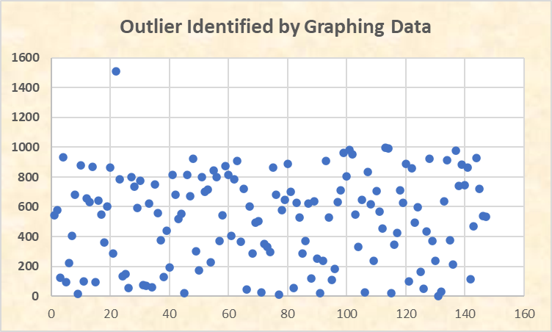
OUTLIERS
Notes:
Excel file has examples.

Slide 37
OUTLIERS– KHAN
Khan Academy
Outliers
Notes:
https://www.khanacademy.org/math/ap-statistics/summarizing-quantitative-data-ap/stats-box-whisker-plots/v/judging-outliers-in-a-dataset

Slide 38
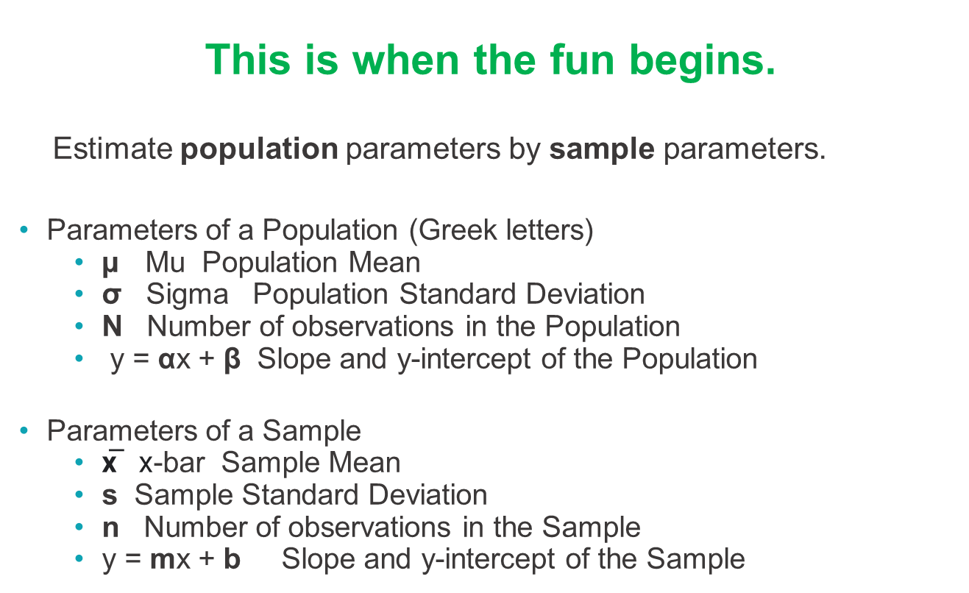
INFERENTIAL STATISTICS
This is when the fun begins.
Estimate population parameters by sample parameters.
Parameters of a Population (Greek letters)
µ Mu Population Mean
$\text{σ}$ Sigma Population Standard Deviation
N Number of observations in the Population
y = αx + β Slope and y-intercept of the Population
Parameters of a Sample
x̅ x-bar Sample Mean
s Sample Standard Deviation
n Number of observations in the Sample
y = mx + b Slope and y-intercept of the Sample

Slide 39
CORRELATION
Two variables are correlated if there is a relationship or connection between them.
The statistical notion of correlation is the correlation coefficient.
The population correlation coefficient is Greek letter rho ρ.
The sample correlation coefficient is r.
r is calculated in excel as r = correl(range1,range2). It is between -1 and +1.
r tells us the sign (direction) of the relationship but not how strong the relationship is.
r-squared tells us how strong the relationship is.
It is the % of the variation in y is explained by the variation in x.
See the next slide for examples

Slide 40
CORRELATION SCENARIOS
r = +1 r-square =1.0
Exact positive relationship between x (horizontal axis) and y (vertical axis).
All the variation in y is due to the variation in x.
r = -1 r-square = 1.0
Exact inverse relationship between x (horizontal axis) and y (vertical axis).
All the variation in y is due to the variation in x.
r = 0.7 r-square = 0.5
Positive relationship between x (horizontal axis) and y (vertical axis).
50% of the variation in y is due to the variation in x.
R = 0.0 r-square =0.0
No linear relationship

Slide 41
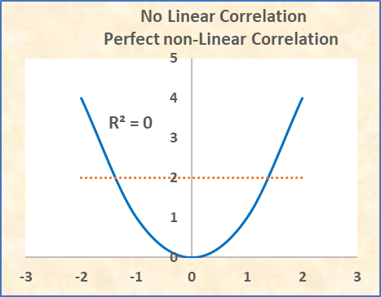
NONLINEAR CORRELATION SCENARIOS
Just because r=0 & r-square = 0 does not mean there is no relationship between x and y.
There is no Linear relationship because the orange line has slope, r, and r-square =0.
But there is a perfect non-Linear relationship on the parabola.

Slide 42
CORRELATION VS. CAUSATION
There may be a correlation between two variables, but that does not
necessarily mean that one causes the other.
Example 1: High correlation, no causation:
Ice Cream sales and baseball homeruns.
Example 2: High correlation with causation.
Weight gain in a rat and amount of food eaten.
PGR charges lower premiums to drivers with high credit scores. This is correlation, but the argument is that people who are responsible with financial decisions are generally more responsible drivers.

Slide 43
CORRELATION VS. CAUSATION – KHAN
Khan Academy
Correlation
Correlation & Causation
Notes:
https://www.khanacademy.org/math/statistics-probability/describing-relationships-quantitative-data/scatterplots-and-correlation/v/correlation-coefficient-intuition-examples
https:/www.khanacademy.org/math/statistics-probability/designing-studies/sampling-and-surveys/v/correlation-and-causality
Instructor & producer(for technical issues) to stay available as ‘office hours’ for any questions.

Slide 44
EXCEL EXERCISES
Go to the Excel exercises in your workbook. The answers are to the far right on each tab.
Tabs
MeanMed
Display
Outlr1
Outlr2
Corr1
Corr2

Slide 45
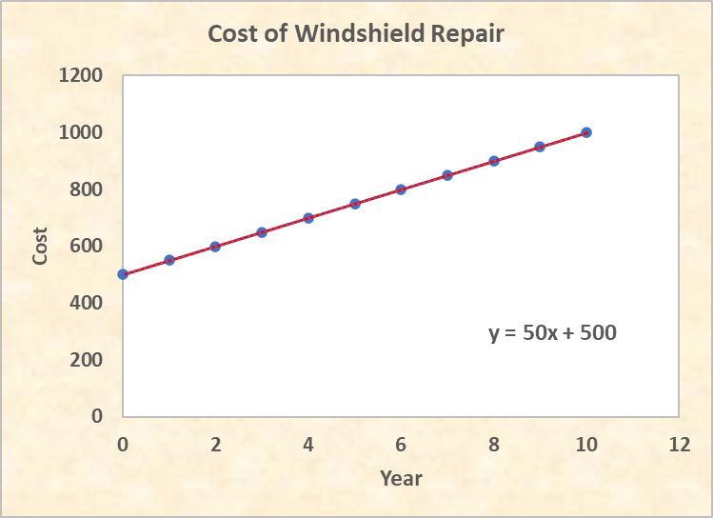
A LINEAR EQUATION IS A STRAIGHT LINE
Slope = 50/year
y intercept = 500

Slide 46
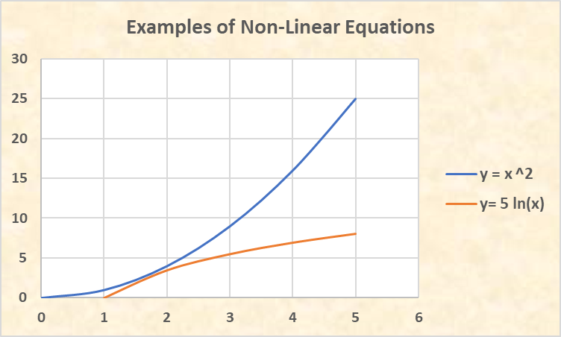
NONLINEAR EQUATIONS ARE NOT STRAIGHT LINES
Examples: y = x^2 y = 5*ln(x)

Slide 47
LINEAR EQUATIONS (TRENDS) CALCULATIONS
A linear equation has the form y = mx + b.
b is the y-intercept: where the line crosses the y axis when x is 0.
m is the slope: the amount y increases when x increases 1 unit.
Method 1 to find the equation y = mx + b: Slope/intercept method
Today’s cost to repair a windshield is $500. The cost increases $50 each year.
How much will a windshield cost to repair 6 years from now?
When x=0, y=$500, so the y-intercept is b = $500.
The cost increases $50 each time x increases by 1, so m = $50.
y = $50x + $500
In year 6: y = ($50)(6) + $500 = $300 + $500 = $800

Slide 48
LINEAR EQUATIONS (TRENDS) CALCULATIONS
Method 2 to find the equation y = mx + b: Two Point Method
Given: (2, 600) and (6, 800) are two points on a line. Find the equation of the line.
x=2, y=600 and x=6, y=800
Compute the slope: (change in y) / (change in x) = (800-600)/(6-2) = 200/4 = 50
So, y = mx + b y = 50x + b
Put either point into the equation to find b: 600 = 50(2) + b 600 = 100 +b b = 500
y = 50x + 500

Slide 49
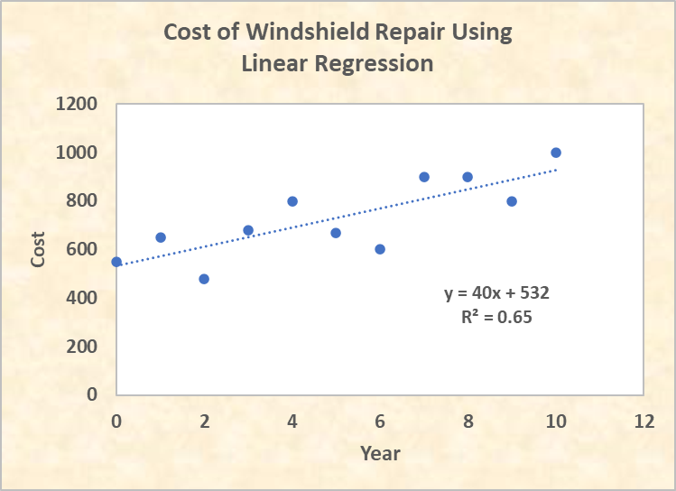
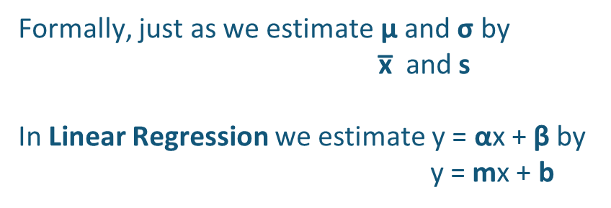
LINEAR REGRESSION
In Algebra, if all the points are on a straight line, the equation is y = mx+ b
In Statistics, the data points are scattered about a straight line. We use Linear Regression to get the formula y = 40x + 532, which is an estimate of the true straight line.
Formally, just as we estimate µ and $\text{σ}$ by
x̅ and s
In Linear Regression we estimate y = αx + β by
y = mx + b

Slide 50
LINEAR REGRESSION
Khan Academy
Linear Regression
Notes:
https://www.khanacademy.org/math/statistics-probability/describing-relationships-quantitative-data/more-on-regression/v/regression-line-example
Instructor & producer(for technical issues) to stay available as ‘office hours’ for any questions.

Slide 51
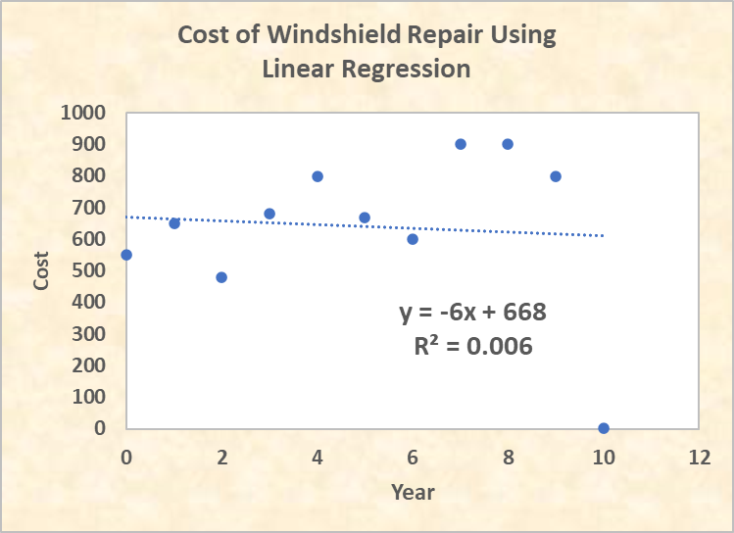
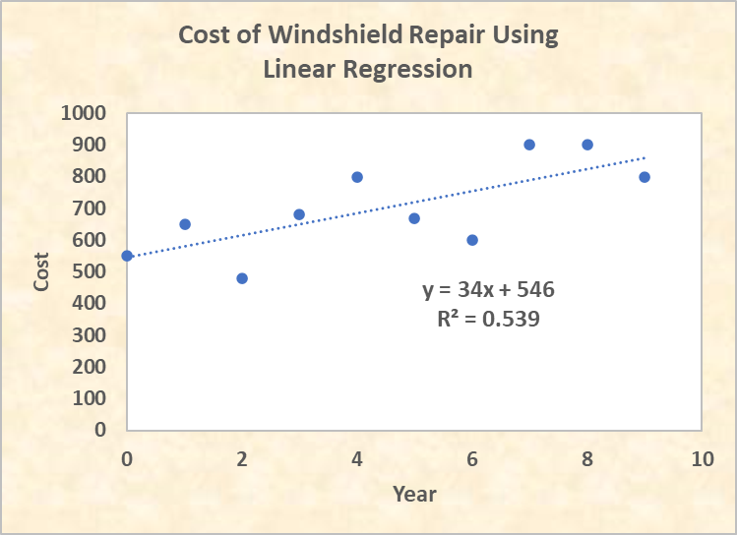
LINEAR REGRESSION - OUTLIERS
If two analysts get different answers, the first place they look is their SQL. But the reason could be the way they handle outliers. The right- hand graph has positive slope because it eliminated the outlier. The left has a negative slope because it did not eliminate the outlier
Outliers can influence the interpretation of a linear regression, even as far as finding a positive or negative slope.

Slide 52
EXCEL EXERCISES
Go to the Excel exercises in your workbook. The answers are to the far right on each tab.
Tabs
LinEq
LinReg
Outlr_LinReg

Slide 53
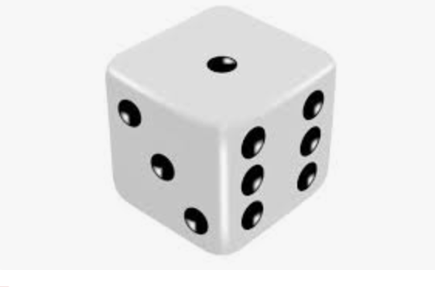
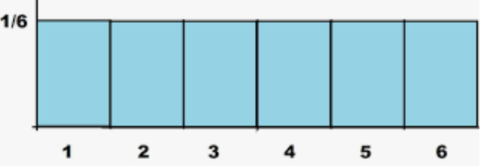
STATISTICAL DISTRIBUTIONS OF DATA
The notion of random variable and statistical distributions:
The value of a variable (X) is not fixed, it is random. (ex. roll a die).
But the value is not totally random. It has a smallest and largest possible value {1, 2, 3, 4, 5, 6}.
The X-values can be displayed on a horizontal number line.
The Y–value associated with the X-value is the probability of the X-value occurring. For the die, the probability of each X is 1/6.
This is a Uniform Distribution
The sum of all the probabilities is 1.0.
1/6 + 1/6 + 1/6 + 1/6 + 1/6 + 1/6 = 1.0

Slide 54
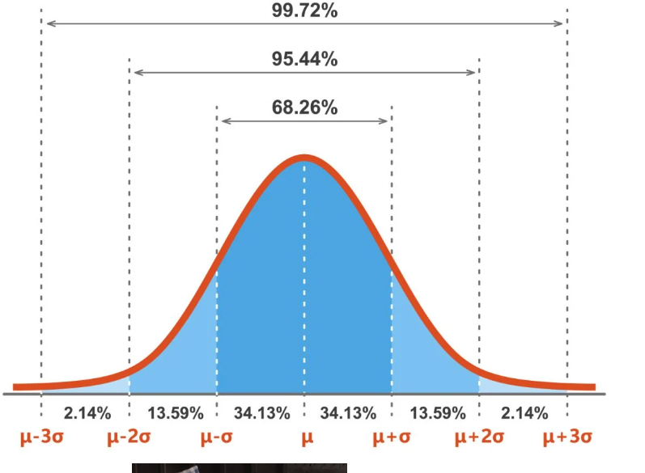
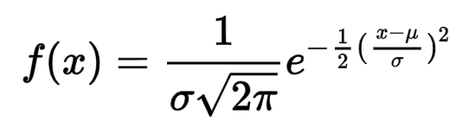
NORMAL DISTRIBUTION – A SPECIAL CASE
Many things in the real world are normally distributed (ex. IQ, hand size).
The equation of the normal distribution is
The total area under the curve is 1.00. Furthermore:
68% of the area is within 1 SD of the mean,
95% within 2 SD,
99.7% within 3 SD.
So, if we have a normal distribution and we know the mean & SD, then we have an excellent idea of the possible values of the random variable.

Slide 55
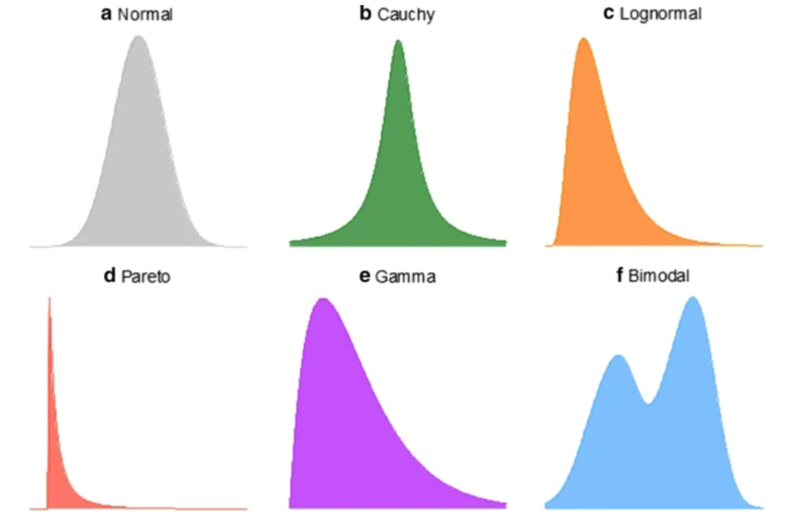
STATISTICAL DISTRIBUTIONS OF DATA
We pay a lot of attention to Normal distributions, giving the impression it is the only one that ever occurs.
But many real-world data sets are not Normally distributed.
Can you give examples of data that has one of the distributions to the left?

Slide 56
NORMAL DISTRIBUTIONS
Khan Academy
Normal Distributions
Notes:
https://www.khanacademy.org/math/ap-statistics/density-curves-normal-distribution-ap/stats-normal-distributions/v/ck12-org-normal-distribution-problems-qualitative-sense-of-normal-distributions
Instructor & producer(for technical issues) to stay available as ‘office hours’ for any questions.

Slide 57
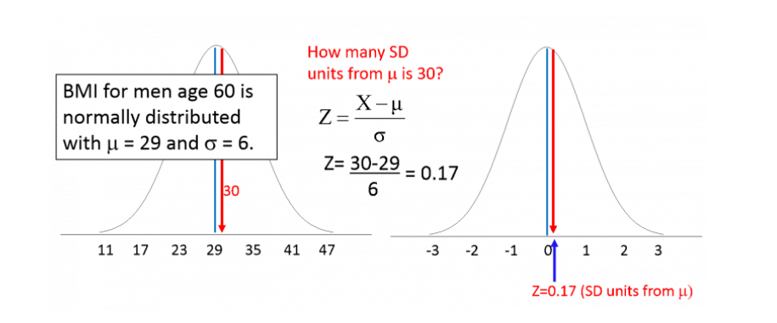
Z-SCORES CONVERT ANY NORMAL DISTRIBUTION TO A STANDARD NORMAL DISTRIBUTION (MEAN=0 SD=1)
The figure on the left is a normal distribution, mean=29, standard deviation=6. What is the probability a BMI is less than 30? This is the area to the left of 30 since the total area = 1.00
The figure on the right re-frames the problem by using a Z-score to transform to a ”standard normal distribution” which has mean=0, standard deviation = 1. We want the area to the left of 0.17.
We re-frame (convert) the problem because there are published tables for the standard normal distribution.

Slide 58
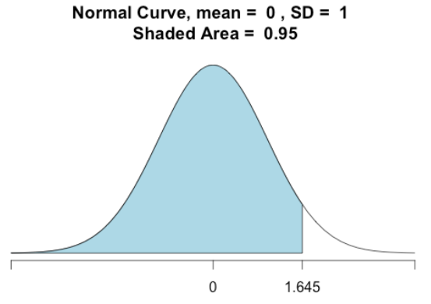
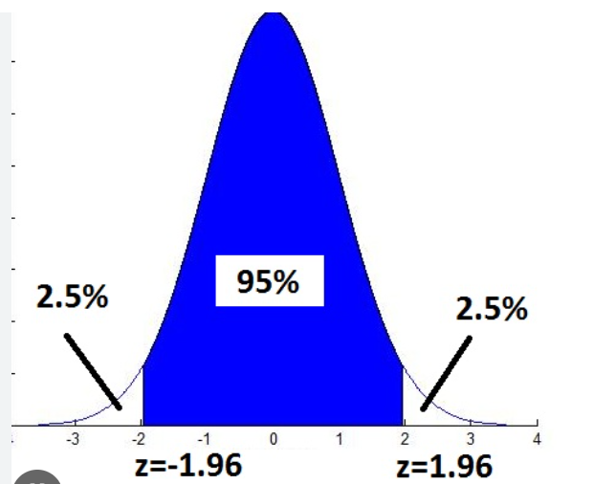
Z-SCORES FOR THE STANDARD NORMAL DISTRIBUTION WHEN P = 0.05
p = 5% is sum of two white areas.
p = 0.05 is the white area.
0.95
1.645 is the 1-tail
Z-score for p=0.05
+1.96, -1.96 are the
2-tail Z-scores for p=5%
Note that 1.96 ~ 2.00

Slide 59
Z SCORES – KHAN
Khan Academy
Z Score Introductions
Notes:
https://www.khanacademy.org/math/ap-statistics/density-curves-normal-distribution-ap/measuring-position/v/z-score-introduction
Instructor & producer(for technical issues) to stay available as ‘office hours’ for any questions.

Slide 60
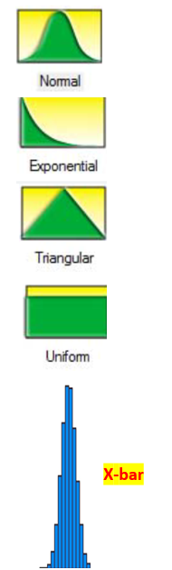
THE CENTRAL LIMIT THEOREM
The Central Limit Theorem (CLT) allows us to make a powerful statement about the distribution of the mean (x-bar) of any shaped probability distribution (top graphs).
Take many samples of size n >30 from the original distribution. Plot the means of those samples on a bar chart. That bar chart will be approximately normally distributed. And it will be skinnier than the original distribution because
the SD(mean) = SD(original distribution) divided by the square root of n.
We will do a class exercise using many samples of size 30 from the uniform distribution and plotting the means of those samples.

Slide 61
CENTRAL LIMIT THEOREM
Khan Academy
Central Limit Theorem
Notes:
https://www.khanacademy.org/math/ap-statistics/sampling-distribution-ap/what-is-sampling-distribution/v/central-limit-theorem

Slide 62
A/B TESTING & CENTRAL LIMIT THEOREM
In A/B testing, we usually have a very large sample size. For example, in an A/B presentation I saw, the sample size was 64,000. The SQRT(64,000) is 253.
The SD(mean) will be extremely small if the SD(sample) is divided by 253 and the Confidence Interval will be extremely small.
There is also the issue of representativeness. Now if we are selecting alternatively 1 A, 1 B etc. this helps to assure representative A and B samples.
So, for all practical purposes, the A/B test results can be treated as “exact numbers” and you don’t need to compute confidence intervals around the averages.

Slide 63
EXCEL EXERCISES
Go to the Excel exercises in your workbook. The answers are to the far right on each tab.
Tabs
NormDist
Z-score
CLT1
CLT2

Slide 64
ADVANCED STATISTICS

Slide 65
ADVANCED STATISTICS TOPICS
Hypothesis Tests for large samples: z-score
Confidence Intervals
Hypothesis Test for small samples: t-score

Slide 66
HYPOTHESIS TESTING
General Logic of Hypothesis Testing (Logic of Opposites)
We hope to demonstrate that something is meaningful. To do so, we assume it is not meaningful and proceed to refute that assumption. Since there are only two possibilities, the alternative, “it is meaningful”, must be true.
Example:
We assume the Null Hypothesis: The true mean is = 0.
The Alternative Hypothesis is: The true mean is not =0.
We allow for a 5% chance that we might be wrong. From a previous slide, the value of Z such that 5% of the
area is to the right of Z is 1.645. That is the critical Z.
Calculate the Z-score for the given data’s mean, assuming the true mean is zero.
4. If calculated Z is > critical Z, that event is “highly unlikely to occur”, so the true mean must not be =0.
If calculated Z is < critical Z, we can’t conclude that the true mean is not =0.

Slide 67
ONE-TAIL HYPOTHESIS TEST FOR THE MEAN
Example: The Countrywide Cost of a Total Loss claim is $21,000. A sample of 100 Total Loss claims from Virginia has a sample mean of $23,170 and a sample SD of $7,000. Is Virginia’s true mean greater than $21,000 at the p=0.05 level of significance?
Null Hypothesis: VA true mean = 21,000.
Alternative Hypothesis: VA true mean > 21,000.
2. This is 1-tail because we want to know if it is “greater than”. Critical Z is 1.64.
3. SD(mean) = [7000/SQRT(100)] = 7000/10 = 700
4. The calculated Z-score is [23,170-21,000] / [SD(mean)] = 2170 / 700 = 3.1
5. Since 3.1 > 1.64, it is “highly unlikely” VA true mean is 21,000. We conclude the VA true mean is >21,000.
What If n=25? SD(mean)=7000/(sqrt(25)) = 1400. Z-score=2170/1400=1.55. Cannot reject the null hypothesis

Slide 68
TWO-TAIL HYPOTHESIS TEST FOR THE MEAN
Example: The average annual PTO time for the last 5 years in Claims has been 3.0 weeks. A sample of 100 PTO records for the current year-to-date has a sample mean of 2.75 weeks and a sample SD of 2 weeks. Is this year’s true mean different than the historical 3 weeks at the p=0.05 level of significance?
Null Hypothesis: the true mean this year is = 3
Alternative Hypothesis: the true mean this year is not = 3.
2. This is 2-tail because “different from” could be positive or negative. The Critical Zs are -1.96 and +1.96.
3. SD(mean) = [2/SQRT(100)] = 2/10 = 0.2
4. The calculated Z-score is [2.75-3] / [SD(mean)] = -0.25/0.2 = -0.125
5. Since -0.125 > -1.96, we cannot reject the null hypothesis that this year’s true mean is 3 weeks..

Slide 69
HYPOTHESIS TESTING
Khan Academy
Hypothesis Testing
Notes:
https://www.khanacademy.org/math/statistics-probability/significance-tests-one-sample/more-significance-testing-videos/v/hypothesis-testing-and-p-values

Slide 70
95% CONFIDENCE INTERVALS
We are 95% confident the true mean is within that interval.
Example: Roadway Service Cost in Pennsylvania
What is a 95% CI for the true mean if the Sample Mean = 41, Sample SD = 15, and the sample size = 25?
1. The sample mean is normally distributed. A 95% interval is the Sample Mean plus/minus 1.96 x SD(mean).
2. The SD(mean) is SD(sample)/SQRT(n) = 15/SQRT(25) = 15/5 = 3
3. A 95% CI in which the true mean lies is 41-(1.96)(3) to 41+(1.96)(3) = 35.1 to 46.9
If a 95% confidence interval for the mean does not include zero, that is equivalent to a Hypothesis Test with p=0.05 rejecting the null hypothesis that mean=0. In my opinion, it is easier to run and explain.

Slide 71
CONFIDENCE INTERVALS
Khan Academy
Confidence Intervals
Notes:
https://www.khanacademy.org/math/ap-statistics/xfb5d8e68:inference-categorical-proportions/introduction-confidence-intervals/v/confidence-intervals-and-margin-of-error

Slide 72
A/B TESTING RELATIONSHIP TO CONFIDENCE INTERVALS
In A/B testing, we usually have a very large sample size. For example, in the earlier A/B presentation, the sample size was 64,000. The SQRT(64,000) is 253.
The SD(mean) will be extremely small if the SD(sample) is divided by 253. The CI will then also be extremely small. So small that for all practical purposes you can treat the results as being “exact”.
So, the values you got (below) can be treated as exact numbers when making the A vs. B comparison and you don’t need to compute confidence intervals around the averages.
51.2% for the average of A
51.7% for the average of B

Slide 73
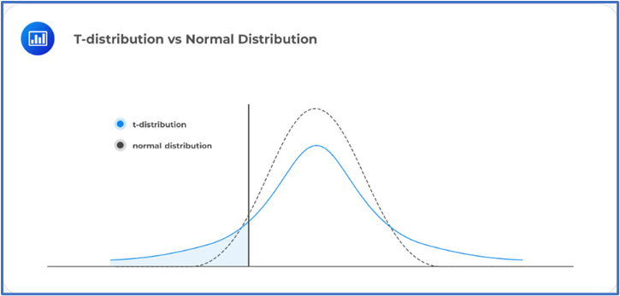
Hypothesis Test for Small Data: t-Test
Notes:
https://www.khanacademy.org/math/ap-statistics/xfb5d8e68:inference-quantitative-means/one-sample-t-interval-mean/v/introduction-to-t-statistics

Slide 74
Hypothesis Test for Small Data: t-Test
A t-test is run the same way as a z-test but is used for small sample size.
Ex: Hailstone size in KS
A sample of size n=9 has a Sample Mean=6.4 inches and a sample SD=12. Is the true mean different from 4 inches (last year’s value) at the p=0.05 level of significance?
1. From the t-table, the 95% critical value of t for a sample of size 9 [(n-1)=8 df] , is 2.306 (larger than z=1.96)
2. SD of the mean = 12/SQRT(9) = 12/3 = 4
3. t-score = (6.4 – 4)/4 = 2.4/4 = 0.60, which is less than 2.306.
We cannot say the true mean is different from 4
Notes:
https://www.khanacademy.org/math/ap-statistics/xfb5d8e68:inference-quantitative-means/one-sample-t-interval-mean/v/introduction-to-t-statistics

Slide 75
EXCEL EXERCISES
Go to the Excel exercises in your workbook. The answers are to the far right on each tab.
Tabs
HypTest
ConfInt
tDist

Slide 76
COURSE GOALS REVISITED
Demonstrate a basic knowledge of Analytics related Algebra concepts.
Demonstrate an understanding of basic Statistics knowledge.
Notes:
Through Advanced Topics section (00:35)
Outro:
During this week, our goals were to demonstrate a basic knowledge of algebra concepts and to have an understanding of statistics knowledge to help you in your analytical role.
Keep in mind that we have squashed a semester’s worth of material to one week. You are not expected to be an expert. The ideas of statistics expand much further. In fact, there are people that major in statistics! Keep an open, learning mind and you’ll be applying statistics without a second thought!

Slide 77
POST-TEST
2 X 2 + 2 X 2 = 4 + 4 = 8
Rebase the series to the last number: 5, 7, 15, 12, 6 0.83, 1.17, 2.5, 2.0, 1.0
What are the first 2 terms of a MA2 for the series above: (5+7)/2, (7+15)/2 = 6, 11
The average is a measure of the central tendency of a set of data.
The standard deviation is a measure of how compact or spread out the data is
Given a Normal Distribution with mean=100 and standard deviation=15, what are the Z-scores that include 95% of the data values? [70, 130]
Explain the Central Limit Theorem? No matter what the distribution of a set of data, the mean of that set of data has a normal distribution.
Advanced
Given a data set of 15 values, and we want to conduct a hypothesis test on the mean, should we use the z-score or t-score? __
The most common level of significance used for Confidence Intervals is: ____

Slide 78
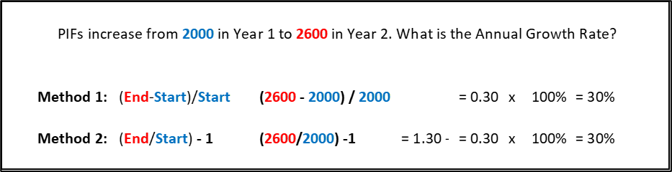
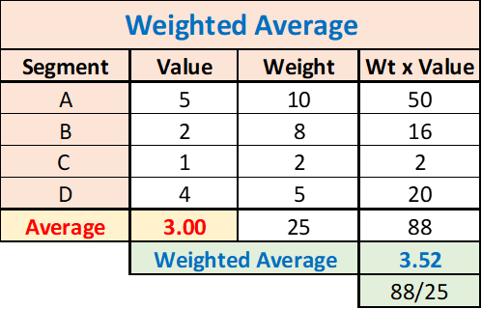
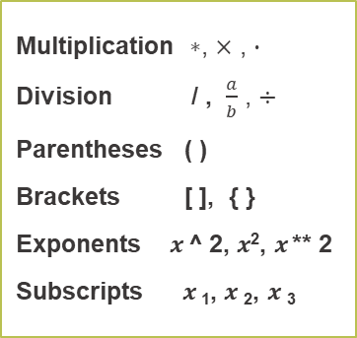
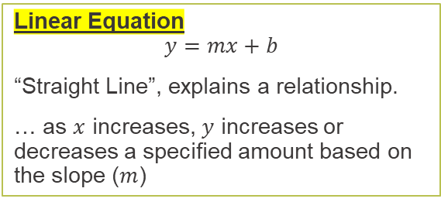
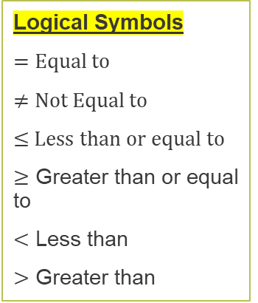
ALGEBRA ON A PAGE
Multiplication $∗$, $×$ , $∙$
Division / , $\frac{a}{b}$ , $÷$
Parentheses ( )
Brackets [ ], { }
Exponents $x$ ^ 2, $x$², $x$ ** 2
Subscripts $x$₁, $x$₂, $x$₃
Rebasing & Relativities
The act of dividing by a “base” or “reference” level is known as rebasing. This process is often used to create easy to digest measures called relativities. It is common to see analyses report measures such as “Loss Ratio Relativities” or “Pure Premium Relativities”.
Orders of Magnitude & Scaling
Explicitly display or represent the scaling base
When conducting analysis, be mindful of scaled variables
Logical Symbols
$=$ Equal to
$≠$ Not Equal to
≤ Less than or equal to
$≥$ Greater than or equal to
$<$ Less than
$>$ Greater than
Order of Operations
Parenthesis
Exponents
Multiplication/Division
Addition/Subtraction
Linear Equation
$$y=mx+b$$
“Straight Line”, explains a relationship.
… as $x$ increases, $y$ increases or decreases a specified amount based on the slope ($m$)
Square: number multiplied to itself.
Exponents: apply multiplication n times.

Slide 79

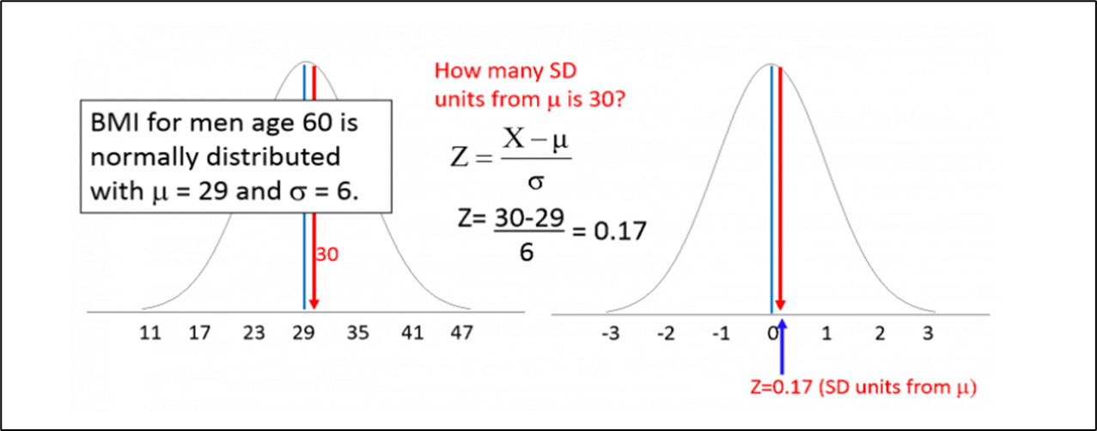
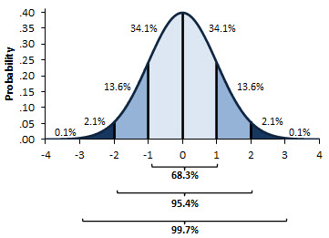
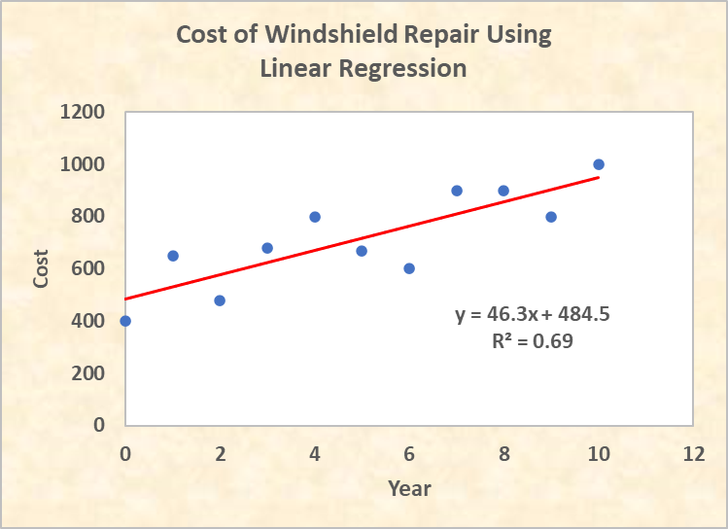
STATISTICS ON A PAGE
Population:
An entire group of people or objects of interest
Sample:
A subset of the population that is studied used to make an inference about the population.
Bias
The sample is not representative of the population.
Inferential Statistics:
Make predictions about the future based on previous data.
Outliers:
Data values that fall outside the expected ranges
Mean, Median, Mode
tells us where the data is centered.
Standard Deviation
tells us how compact or spread out the data is.
Z-score
Central Limit Theorem
Normal Distribution
Linear Regression

